Slide 1


Master of Science in European Forestry

Slide 2

MSc in European Forestry
MSc European Forestry (MSc EF) is a top class taught 2-year (120 ECTS) double-degree Erasmus Mundus Joint Master Degree Programme (EMJMD) in the field of forest sciences

Slide 3
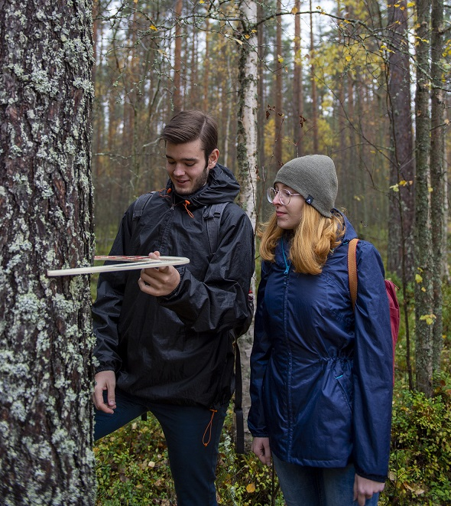
Aim of the programme
The aim of the MSc EF programme is to educate professionals who have a thorough understanding of a sustainable forest bioeconomy as well as European business culture
MSc EF is one of the first EMJMD programmes that has been accredited according to the European approach for quality assurance of the joint programmes

Slide 4
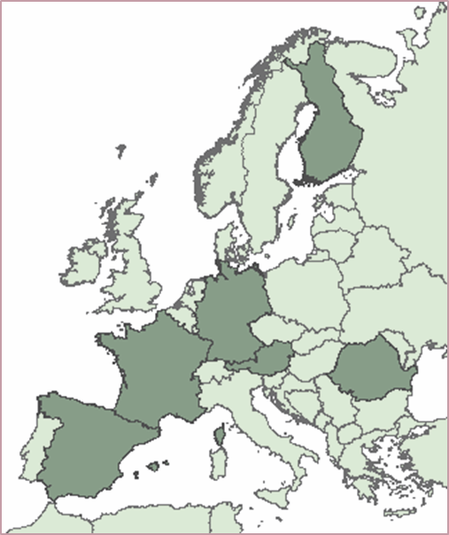
The MSc EF Consortium
  Full Partners: Six high-level European universities
  University of Freiburg (Germany)
  University of Natural Resources and Life Sciences, Vienna (Austria)
  University of Lleida (Spain)
  University of Eastern Finland (Finland)
  AgroParisTech (France)
  Transilvania University of Brasov (Romania)

Slide 5
Associated Partner Universities
  Brazil: Federal University of Paraná and São Paulo University
  China: Northwest A&F University
  Canada: University of British Columbia and University of New Brunswick
Associated Scientific and Industrial Partners
  Arbonaut, Austrian Research Centre for Forests, Centre INRA Grand-Est-Nancy, Centre Tecnològic Forestal de Catalunya, Chinese Academy of Forestry, Diputació de Barcelona, District Forest Office (Forstamt) Johanniskreuz, European Forest Institute, International Institute for Applied Systems Analysis, Ocolul Silvic Ingleby, Office National des Forêts, SC Tornator Romania SRL and StoraEnso Wood Supply

Slide 6
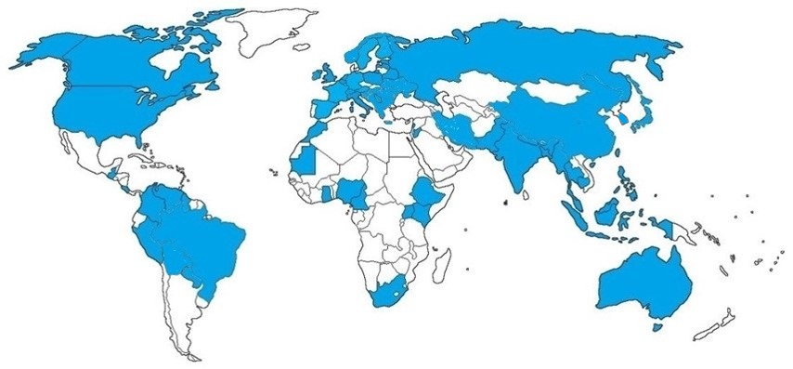

MSc European Forestry students
43 | Brazil
36 | Spain
25 | Nepal
20 | Bangladesh
19 | China
18 | Germany
18 | Philippines
16 | India
13 | Indonesia
13 | Russia
9 | Myanmar
9 | Netherlands
8 | Canada
8 | USA
8 | Nigeria
8 | Serbia
7 | Ethiopia
6 | Romania
5 | Columbia
6 | Vietnam
5 | Peru
4 | Finland
4 | Poland
4 | Taiwan
4 | Thailand
4 | UK
3 | Belgium
3 | Bhutan
3 | Costa Rica
3 | France
3 | Ghana
3 | Greece
3 | Guatemala
3 | Ireland
3 | Latvia
3 | Pakistan
3 | South Africa
3 | Tanzania
2 | Austria
2 | Bosnia and Herzegovina
2 | Cameroon
2 | Iran
2 | Japan
2 | Jordan
2 | Kosovo
2 | Lebanon
2 | Morocco
2 | Paraguay
2 | Sweden
2 | Uganda
2 | Ukraine
1 | Australia
1 | Bolivia
1 | Cambodia
1 | Estonia
1 | Belarus
1 | Guyana
1 | Hong Kong
1 | Hungary
1 | Italia
1 | Kenya
1 | Kyrgyzstan
1 | Malaysia
1 | Mauritania
1 | Moldova
1 | Nicaragua
1 | Norway
1 | Slovenia
1 | South Korea
1 | Switzerland
1 | Venezuela
2002-2024: 403 students from 71 countries

Slide 7
Programme structure
The first year provides students with a complete background in European forestry and familiarises them with the 6 partner universities and with other forest institutions

Slide 8
The second year takes place at one of the Partner Universities (not UEF)
During the second year, students attend courses and carry out the Master thesis at the partner university, according to an individual study plan agreed with the supervisor
Each student who has successfully completed studies will obtain a MSc EF Double Degree Certificate and a Diploma Supplement. One of the certificates is always awarded by the University of Eastern Finland whereas the other certificate is awarded by the Partner University that hosts the student during the advanced studies of the second study year.
YEAR 2 60 ECTS | Courses | ECTS | Location
 | Advanced courses | 30 | Student’s preferred Partner University
 | Master’s Thesis | 30

Slide 9

The employability of the graduates
The curriculum is specifically designed to take into consideration the needs of potential employers and therefore our graduates are highly valued by national and international agencies, governmental bodies, NGOs, research institutions and timber, paper and pulp enterprises

Slide 10

About 300 graduated students
About 60% works in his/her own home country
About 40% works abroad

Slide 11
Universities (lecturers/PhD students) 45%, e.g:
University of Eastern Finland
University of Helsinki, Finland
Lakehead University, Canada
University of New Brunswick, Canada
BOKU, Austria
University of Freiburg, Germany
AgroParisTech, France
Shanghai University, China
University of A&F, China
Kasertsart University, Thailand
Chinese Academy of Forestry, China
11

Slide 12
Research institutes and governmental bodies and
other organisations (35%), e.g:
Thai Research Fund, Bangkok, Thailand
Ministry of Forestry, Indonesia
Ministry of Forestry, Nepal
Forest Technological Centre of Catalonia, Spain
Potsdam Institute for Climate Change, Germany
Ecology Lab of the Andalusian Center of Environment, Granada, Spain
Climate Bridge Ltd., China
The Nature Conservancy, Indonesia
World Agroforestry Center, South East Asia Region, Indonesia
IUFRO

Slide 13
Private corporations (20%), e.g:
Netherlands Development Finance Bank, the Netherlands
Sutherland Seedlings, South Africa
Arbonaut Ltd., Finland
Mondi Business Paper, South Africa
Corporacion Fondo Biomercio, Colombia
Climate Bridge Ltd., China
UPM, Russia
IKEA, Indonesia
Read more about the employment of our graduates at:
https://sites.uef.fi/europeanforestry/employment/

Slide 14
Fees, waivers and scholarships and instructions on how to apply for admission

Slide 15
Fees
Annual consortium fees for non-EU/EEA students are 9 000 EUR. There are no consortium fees for students who are citizens of EU/EEA countries or Switzerland. The consortium fees are to be paid semestrial basis in advance.

Slide 16
Scholarships
The information on possible scholarships available in 2025 can be found at the programme’s website in spring 2025.

Slide 17
How to apply?
The call for applications is open 16 Dec – 22 Jan 2025
Minimum application requirements
  BSc in Forestry or in a related field & good skills in English
  See the detailed application requirements and instructions on how to apply at the following programme website:
  https://sites.uef.fi/europeanforestry/how-to-apply/

Slide 18
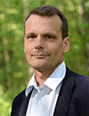

Contact information
Academic director
Professor Timo Tokola
email. timo.tokola(at)uef.fi
tel. +358 50 401 5835
Coordinator
Dr. Marjoriitta Möttönen
email. marjoriitta.mottonen(at)uef.fi
tel. +358 50 442 3031

Slide 19
Thank you

