Slide 1



Master of Science in European Forestry

Slide 2
MSc in European Forestry
MSc European Forestry (MSc EF) is a top class taught 2-year (120 ECTS) Erasmus Mundus Joint Master Programme (EMJM) in the field of forest sciences

Slide 3
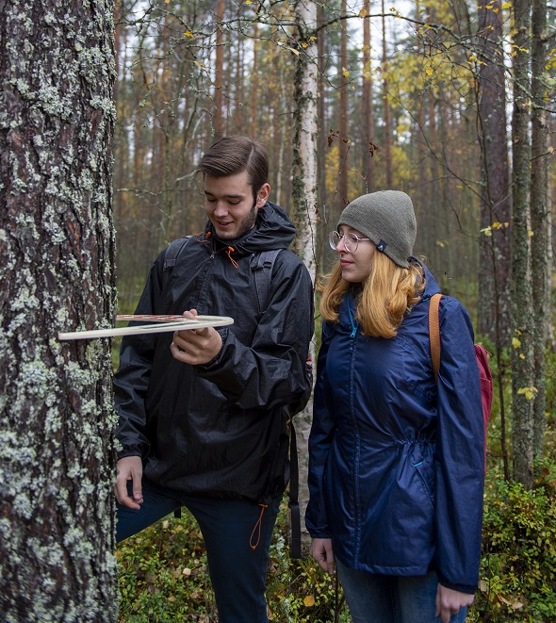
Aim of the programme
Our aim is to prepare professionals to tackle the four Grand Challenges in forestry:
  1) Climate change and the increasing frequency and intensity of natural disturbances,
  2) Lack of biomass for the bioeconomy industry and mitigating CO2 emissions,
  3) Declining biodiversity and conversion of forest land to other land uses, and
  4) Increasing societal demand for non-market ecosystem services.

Slide 4
The MSc EF Consortium
  Full Partners: Seven high-level European universities
  AgroParisTech (France)
  BOKU University (Austria)
  University of Eastern Finland (Finland)
  University of Freiburg (Germany)
  University of Lleida (Spain)
  Transilvania University of Braşov (Romania)
  Wageningen University (the Netherlands)

Slide 5
Associated Partner HEIs:
Agricultural University of Tirana (Albania), Federal University of Paraná (UFPR, Brazil), Lakehead University (Canada), Michigan State University (MSU, the USA), Moldova State University (USM, Moldova), National University of Life and Environmental Sciences of Ukraine (NUBiP, Ukraine), Northwest A&F University (NWAFU, China), Stellenbosch University (SU, South Africa), Technical University of Moldova (UTM, Moldova) Ukrainian National Forestry University (UNFU, Ukraine), University of British Columbia (UBC, Canada), University of Ibadan (UI, Nigeria), University of New Brunswick (UNB, Canada) and University of São Paulo (USP, Brazil).
Associated Industrial/Public/NGO Partners:
Arbonaut Ltd. (Finland), Austrian Research Center for Forests (BFW, Austria), Centre INRAE Grand-Est-Nancy (INRAE, France), European Landowners’ Organization (ELO, Belgium), Forest Ownership Centre of Catalonia (Spain), Forest Science and Technology Centre of Catalonia (CTFC, Spain), FSC International Center GmbH (FSC GD, Germany), Chinese Academy of Forestry (CAF, China), European Forest Institute (EFI, Finland), Forstamt Johanniskreuz (Germany), Hasslacher Holding GmbH (Austria), International Institute for Applied Systems Analysis (IIASA, Austria), Ocolul Silvic Ingleby (Romania), Office National des Forêts (ONF, France), PEFC (Germany), Ponsse Plc. (Finland), Société Forestière de la CDC (France), Stora Enso Oyj (Finland) and Tornator SRL (Romania).

Slide 6
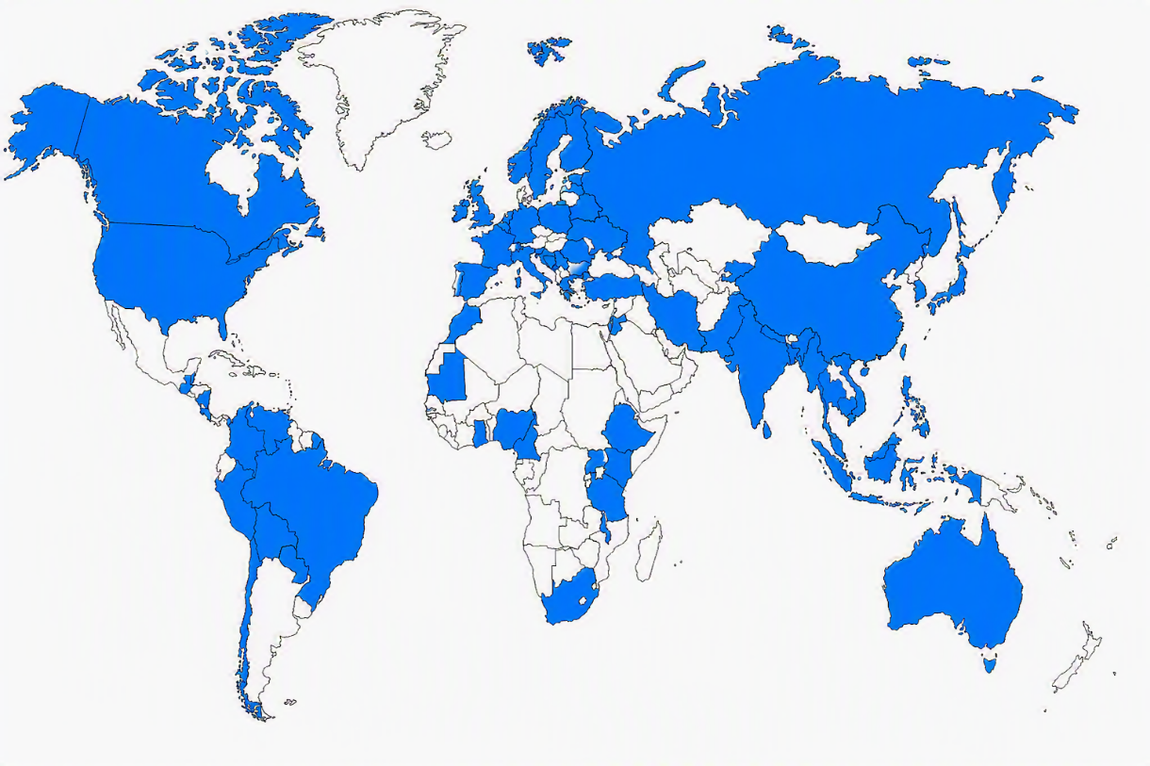

MSc European Forestry students
45 | Brazil
36 | Spain
26 | Nepal
21 | China
21 | Germany
20 | Bangladesh
17 | Philippines
16 | India
15 | Indonesia
13 | Russia
12 | Nigeria
11 | The Netherlands
9 | Myanmar
8 | Canada
8 | Ethiopia
8 | Serbia
7 | USA
6 | Romania
6 | Vietnam
5 | Columbia
5 | Peru
5 | Taiwan
4 | Belgium
4 | Finland
4 | Pakistan
4 | Poland
4 | Thailand
4 | UK
3 | Bhutan
3 | Costa Rica
3 | France
3 | Ghana
3 | Greece
3 | Guatemala
3 | Latvia
3 | South Africa
3 | Tanzania
2 | Australia
2 | Austria
2 | Bosnia and Herzegovina
2 | Cameroon
2 | Iran
2 | Ireland
2 | Japan
2 | Jordan
2 | Kosovo
2 | Lebanon
2 | Morocco
2 | Paraguay
2 | South Korea
2 | Sweden
2 | Uganda
2 | Ukraine
1 | Belarus
1 | Bolivia
1 | Cambodia
1 | Chile
1 | Estonia
1 | Guyana
1 | Hong Kong
1 | Hungary
1 | Italia
1 | Kenya
1 | Kyrgyzstan
1 | Malaysia
1 | Mauritania
1 | Moldova
1 | Nicaragua
1 | Norway
1 | Slovenia
1 | Sri Lanka
1 | Switzerland
1 | Turkey
1 | Venezuela
2002–2026: 424 students from 74 countries

Slide 7
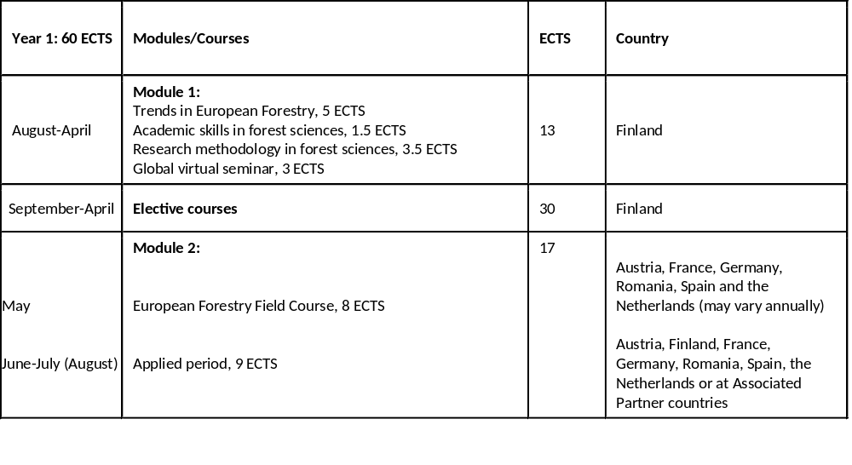
Programme structure
The first year provides students with a complete background in European forestry and familiarises them with the 7 Full Partner universities and with the Associated Partner organisations.

Slide 8
The second year takes place at one of the Full Partner universities (not at the UEF).
During the second year, students attend courses and carry out the Master thesis at the Full Partner university, according to an individual study plan agreed with the supervisor.
Each student who has successfully completed studies will obtain a Double or a Joint Degree Certificate and a Joint Diploma Supplement.
YEAR 2 60 ECTS | Courses | ECTS | Location
 | Advanced courses | 30 | Student’s preferred Full Partner university
 | Master’s Thesis | 30

Slide 9

The employability of the graduates
The curriculum has been carefully designed to meet the needs of potential employers. As a result, our graduates are highly valued by national and international organizations, including government agencies, NGOs, research institutions, and companies operating in the forestry, timber, paper, and pulp sectors

Slide 10

More than 350 graduated students
About 60% works in his/her own home country
About 40% works abroad

Slide 11
Universities (lecturers/PhD students) 45%, e.g:
University of Eastern Finland
University of Helsinki, Finland
Lakehead University, Canada
University of New Brunswick, Canada
BOKU, Austria
University of Freiburg, Germany
AgroParisTech, France
Shanghai University, China
University of A&F, China
Kasertsart University, Thailand
Chinese Academy of Forestry, China
11

Slide 12
Research institutes and governmental bodies and
other organisations (35%), e.g:
Thai Research Fund, Bangkok, Thailand
Ministry of Forestry, Indonesia
Ministry of Forestry, Nepal
Forest Technological Centre of Catalonia, Spain
Potsdam Institute for Climate Change, Germany
Ecology Lab of the Andalusian Center of Environment, Granada, Spain
Climate Bridge Ltd., China
The Nature Conservancy, Indonesia
World Agroforestry Center, South East Asia Region, Indonesia
IUFRO

Slide 13
Private corporations (20%), e.g:
Netherlands Development Finance Bank, the Netherlands
Sutherland Seedlings, South Africa
Arbonaut Ltd., Finland
Mondi Business Paper, South Africa
Corporacion Fondo Biomercio, Colombia
Climate Bridge Ltd., China
UPM, Russia
IKEA, Indonesia
Read more about the employment of our graduates at:
https://sites.uef.fi/europeanforestry/employment/

Slide 14
Fees, waivers and scholarships and instructions on how to apply for admission

Slide 15
Fees
Annual consortium fees for non-EU/EEA students are 9 000 EUR. There are no consortium fees for students who are citizens of EU/EEA countries or Switzerland. The consortium fees are to be paid semestrial basis in advance.

Slide 16
Scholarships
Erasmus Mundus scholarships from 2026 onwards
  The Erasmus Mundus scholarship covers participation costs (including the consortium fees), full insurance coverage, and a monthly subsistence allowance for the entire duration of the study programme, 1400 EUR/month (max. 24 months).
  The scholarships are available for non-EU/EEA and EU/EEA students, and the total amount of the scholarship is the same for all students.
  Read more on Erasmus Mundus Joint Masters in the European Commission website.
In addition, the MSc EF Consortium may grant partial consortium fee waivers (50–75%) for the best applicants. See the details at www.europeanforestry.eu

Slide 17
How to apply?
The call for applications is open 2 Dec 2026 – 13 Jan 2027
Minimum application requirements
  BSc in Forestry or in a related field & good skills in English
  See the detailed application requirements and instructions on how to apply at the following programme website:
  https://sites.uef.fi/europeanforestry/how-to-apply/

Slide 18
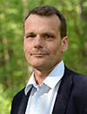
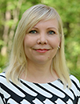
Contact information
Academic director
Professor Timo Tokola
email. timo.tokola(at)uef.fi
tel. +358 50 401 5835
Coordinator
Dr. Marjoriitta Möttönen
email. marjoriitta.mottonen(at)uef.fi
tel. +358 50 442 3031

Slide 19
Thank you

