Slide 1
Greek Team 2
Water Footprint

Slide 2
What is water footprint?
https://www.youtube.com/watch?v=az7Lrdq66mM

Slide 3
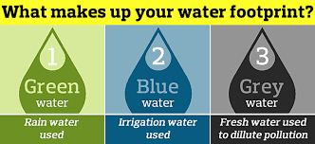
It is the amount of water consumption caused by a product or service, directly or indirectly, in the process from the first production stage to the delivery to the end user. Water footprint calculation is done not only for our basic activities such as eating, drinking, personal care, cleaning, etc., but for every daily or non-daily action and every product.
https://www.youtube.com/watch?v=2T_n0oi9YdY

Slide 4
Water footprint does not only apply on the food we consume, but also on the clothes we wear, the items we use; It is calculated in every subject such as housing, transportation, entertainment, education, business life. It is an account that shows the development level of countries, measures the tendency of institutions to environmental issues, and shows how conscious individuals are about water use.
https://live.staticflickr.com/8108/8558534231_1a46b24b6d.jpg

Slide 5
Water footprint in fashion industry

Slide 6
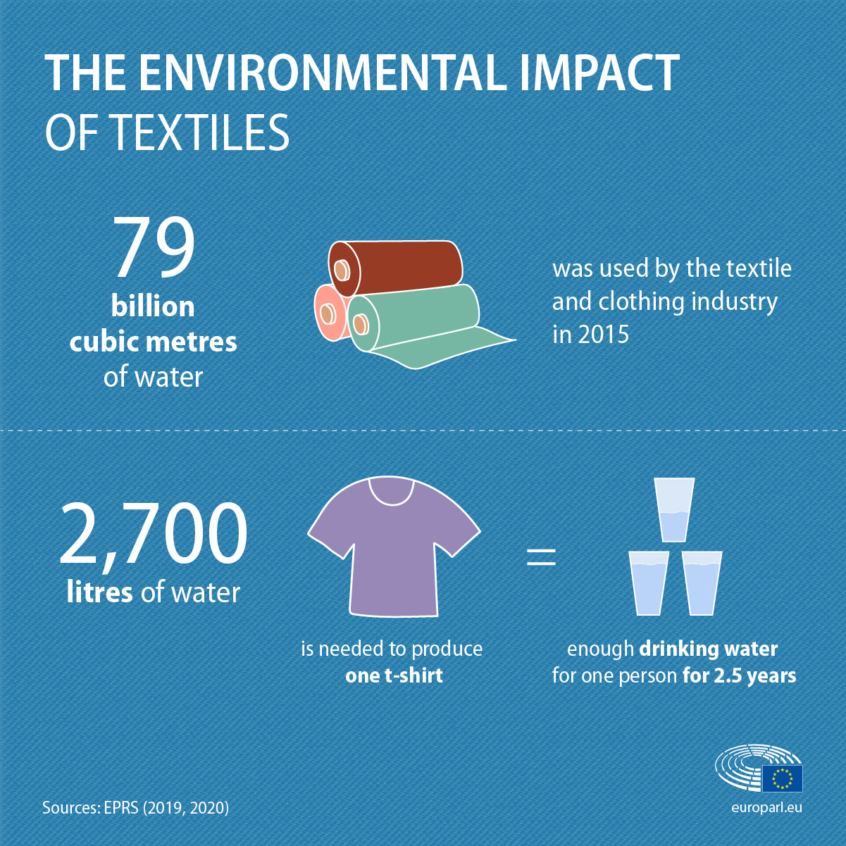
The fashion industry is a massive consumer and polluter of our fresh water. It is the second most water-intensive industry in the world, consuming around 79 billion cubic meters of water per year.
https://www.europarl.europa.eu/resources/library/images/20201214PHT93872/20201214PHT93872_original.jpg

Slide 7
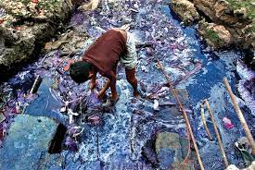
To put this into context, this is enough to fill 32 million Olympic-size swimming pools. The most shocking fact is that this figure is expected to increase by 50% by 2030.
https://www.youtube.com/watch?v=BiSYoeqb_VY

Slide 8
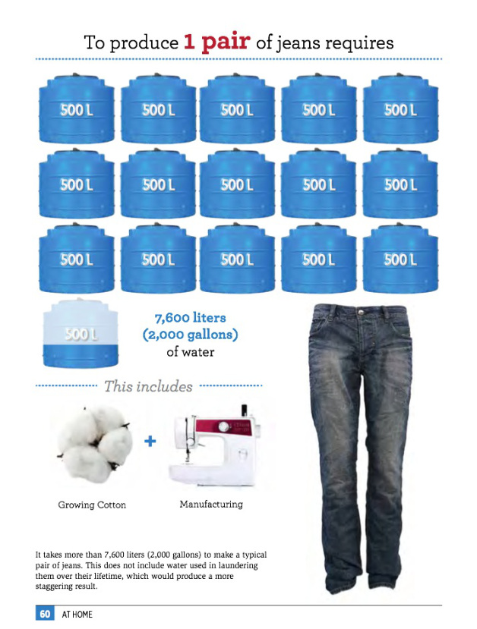
One of the biggest culprits is cotton. Producing a simple cotton T-shirt consumes a 900 days worth of drinking water. 2700 liters in particular. Annually, 2 billion of these T-shirts are being sold around the world. To produce a pair of Jeans 7600 liters of water are needed. This means that your casual outfit consumes more than 10.000 liters of water!!!
https://sophelise.files.wordpress.com/2017/01/f5239-jeans2binfographic.jpg

Slide 9
Water pollution

Slide 10
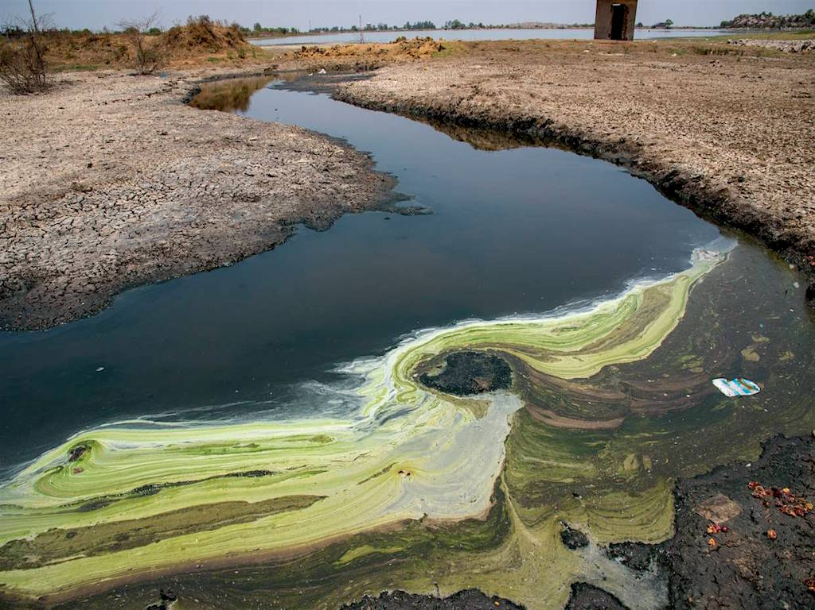
Fashion industry is not only a gigantic water consumer, but also the second largest water polluter after agriculture. It’s estimated that around 20% of industrial water pollution in the world comes from the treatment and dyeing of textiles, and about 8,000 synthetic chemicals are used to turn raw materials into textiles.
https://www.youtube.com/watch?v=NXTIfcfzSnE

Slide 11
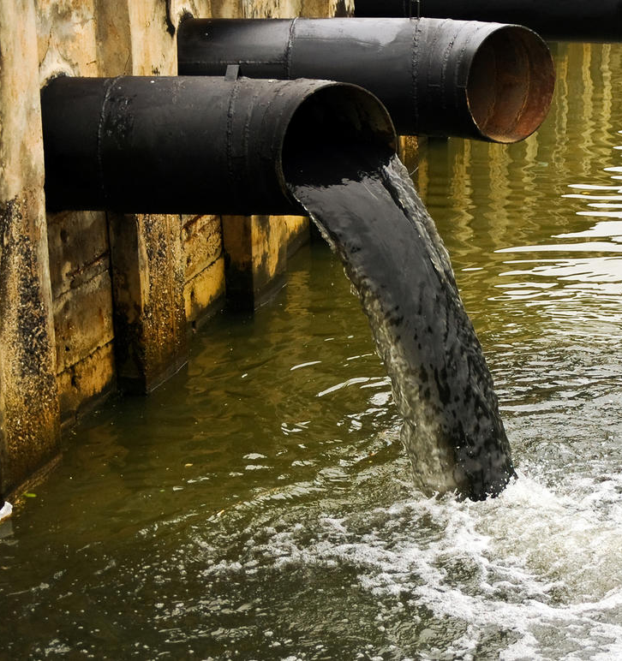
Each year, textile companies discharge millions of gallons of chemically infected water into our waterways. It’s estimated that a single mill can use 200 tons of fresh water per ton of dyed fabric.

Slide 12
COMMUNICATE THE PROBLEM
Tell your friends
1
Tell your family members
2
Tell the students in your school
3
Tell your community members
4
Tell everyone you know
5
THAT IS WHAT WE DID

Slide 13
Quiz 1
What is water footprint?
A measure of humanity’s appropriation of fresh water in volumes of water consumed and/or polluted.
A statement we use for how much water we use only in textile
A measure of how secure are our food or energy supplies
The water footprint statement is used to give punishment people for unfair and harshly consumption of water
Notes:
Correct answer: a

Slide 14
Quiz 2
How many days of drinking water by an average person does the production of a single T-shirt consume?
3
300
900
1500
Notes:
Correct answer: c

Slide 15
Quiz 3
Why are water footprints so important?
Because freshwater is a scarce resource; its annual availability is limited and demand is growing.
Because water users generally do pay for the negative impacts that they cause on downstream people or ecosystems.
Because freshwater availability on earth is not limited it is not important to know how it is allocated over various purposes
Because the big percentage of natural spring water all over the world should be spent only for food.
Notes:
Correct answer: a

Slide 16
Quiz 4
What percentage of industrial water pollution in the world comes from the treatment and dyeing of textiles?
5%
20%
26%
53%
Notes:
Correct answer: b

Slide 17
THANK YOU FOR YOUR ATTENTION

