Slide 1
Trauma and Life Course Planning in Emerging Adulthood: Healing Conditions that Support Aspiration and Hope
Donna M. San Antonio ~ Lesley University, Cambridge, MA
International Scientific Seminar: Life Designing Interventions
Lausanne, Switzerland ~ 6 March, 2020

Slide 2
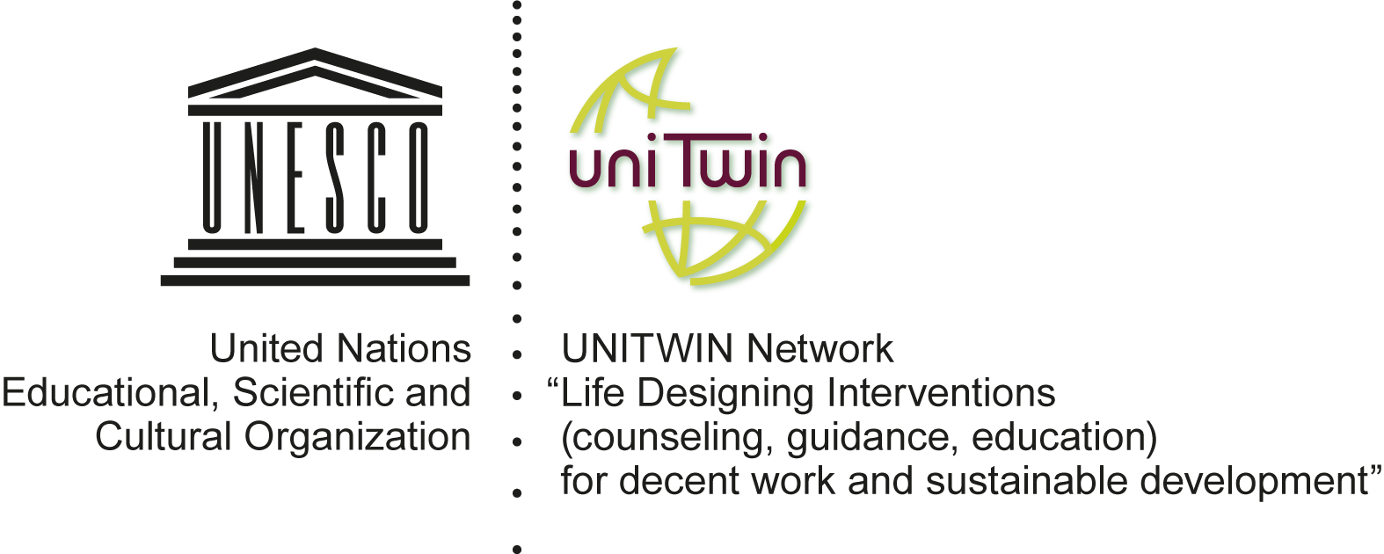
UNESCO-UNITWIN Perceptions of decent work and future among emerging adults without qualifications

Slide 3
Research Focus and Questions
FOCUS: Work lives of rural emerging adults without high school diploma
FROM: Work narratives about work conditions and attitudes, TO: Life narratives that revealed histories of significant disruption in family life, schooling, home, and peer relationships.
As trauma and disrupted attachment themes emerged: How did research participants persist through adversity? How did disaffiliation and disruption continue to trouble their lives?
Is there evidence of going beyond internal and external constraints and dictates in order to re-create a narrative that is hopeful and authentic? If so, what facilitated this?

Slide 4
Research Design and Participants
Participants
10 research participants without a high school diploma, 5 men and 5 women, White, low-SES, 19.5 to 24 years old, referred through Adult Education Centers
Data Collection
Analysis
Semi-structured interviews, 1-2 hours; Narrative Inquiry
Thematic Analysis
Employment
Restaurant or coffee shop (4), Factory assembly work (2), Construction/Yard work (3), Bus trainee (1)
Researcher Positionality
Teacher, School Counselor, Community Non-Profit Youth Service Director
Challenges
Rural, low-resourced area; hard to find 20-25 year-olds who had steady employment

Slide 5
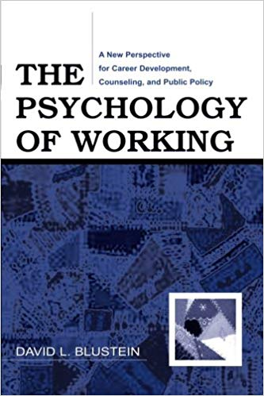
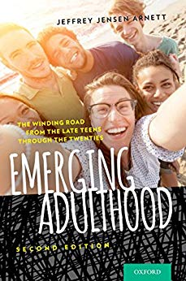
Theoretical & Conceptual Frameworks
Psychology of Working Theory (Blustein, 2006…)
Psychology of Hope (Snyder, 2003)
Developmental Features of Emerging Adults (Arnett, 2015)

Slide 6
Psychology of Working Theory
Socio-Cultural Conditions
Power, control, exclusion, oppression, bias, social and economic depravation
Moderating Factors (internal and external)
Proactive personality
Critical consciousness
Social support
Just and fair economic conditions
Optimal work pathways
Decent Work
Survival needs + Social connectedness + Self-determination
(Blustein, 2006, 2013, 2019; Duffy, Blustein, Diemer, & Autin, 2016)

Slide 7
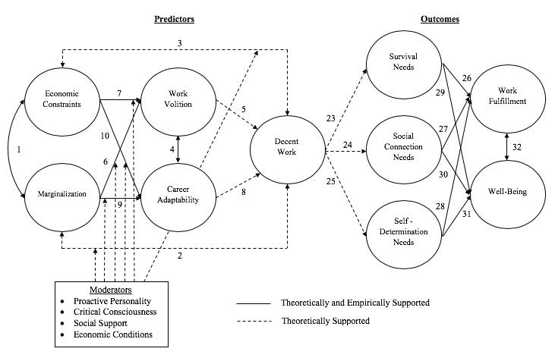
Psychology of Work Theoretical Model (Duffy, Blustein, Deimer, & Autin, 2016)

Slide 8
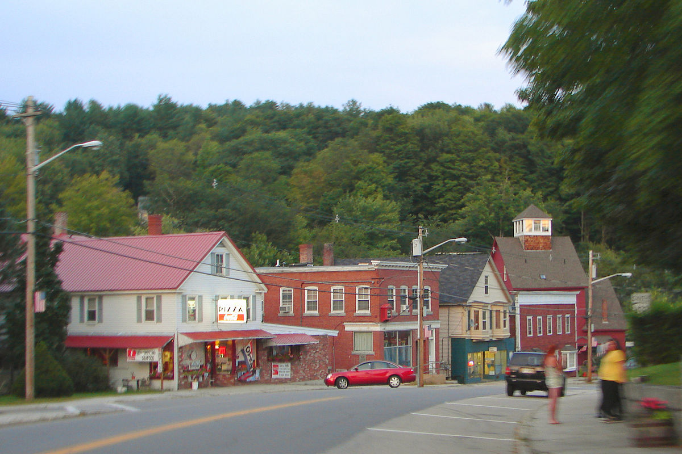
Economic Constraints
In rural regions of the U.S., 20.3% of 20-24-year-olds are not in education, employment, or training (NEET)— a higher proportion than any other demographic, and a key factor in out-migration of rural emerging adults to urban areas (Burd-Sharps & Lewis, 2017).
Very wide economic disparities, Seasonal tourism and retail economy, No public transportation
Higher rates of poverty, addiction, and disability
Low access to services, such as
continuing education, childcare, healthcare, jobs

Slide 9
Marginalization
School and Home Disruption
Characteristic No. of Participants
(Total N=10)
Experienced low family income during childhood 10
Interrupted high school, later enrolled in adult education 10
Began working by age 14-15 10*
Experienced separation from a primary caregiver in childhood 9
Inconsistent home, school, family, community contexts growing up 9
Living away from home by age 18 8
Currently in a job without health benefits 8
Work compensation goes entirely to day-to-day expenses 8**
Mental health diagnosis and/or addiction history 7
Homelessness in childhood and/or adolescence 6***
NEET at some time in previous 2 years 5**** (1 woman, 4 men)
Had a child before the age of 20 3
* One began working at age 11; **Two were saving for future education or housing; ***Two were homeless at the time of the interview; **** Not in education, employment, or training

Slide 10
Kicked Out “They just let you go”
I loved elementary school. I loved learning. I loved schoolwork. I was good at it… [but] I wasn’t very good with social interactions…And I was also going through some emotional stuff on my own. I couldn’t make it to school anymore…They just let you go….there was no pressure for me to finish school.
“Someone should have reached out”
If someone would have reached out to me, I would have been better off… I would have been able to maybe start my journey into bettering myself sooner… I feel there’s no way my teachers didn’t see at least some portion of what was going on…someone should have reached out.

Slide 11
Disrupted Attachment and On-going Disconnection
I had no social skills. The relationships with my friends were poor and weak because I didn’t really know how to develop an emotional connection with another person.
I never had many friends…I just didn’t fit in…I was a little too much for what people wanted me to be… I just had issues connecting with people and having friends [but] I hate being alone…I just drown in everything until I spill out a little bit on everybody or until I blow up, and then all over again I reseal it and I re-stuff everything, and it’s just a never-ending cycle of freaking out.

Slide 12
Work Volition and Career Adaptability “You get burnt out as a human being…”
…I just didn’t care about anything. There was just a complete lack of enthusiasm, where I was just, like, I was just existing…I just had all these obstacles getting in the way. And then eventually you get burnt out as a human being, so you’re just like, okay, you throw your hands up and you just give up.

Slide 13
Moderating Factors
Economic Conditions (Negative Impact)
Critical Consciousness (Negative Impact)
Social Support (Negative in the Past; Moderately Positive Now )
I was very isolated from the world—when you turn 18 you get to the point where you feel like you’ve been sleeping 18 years
Extended family, teachers, and bosses as mentors
Proactive Personality (Positive)
I always like to do things the best that I can when I’m at work…Work’s really important to me and I think that’s probably where I’m going to find a lot of satisfaction in my life… I would like work that’s challenging and novel.

Slide 14
Outcomes: Value of Work to Me
Survival Needs
I’m not really accomplishing much. I’m making somebody else money and paying my bills…but there’s like no meaning really to me.
Social Connection
I feel the need to connect with people as part of a job

Slide 15
Outcomes: Value of Work to Others
Work Fulfillment and Future Orientation
If I hadn’t had someone at 15…I’m not sure where I would be. Work for me is a way of helping people…I want to open up a foster care for homeless kids.
Money is not all there is… I can actually do something…on a greater scale, you could internationally try and solve these problems.
Well-being and Self-determination
You know, like it makes me feel like I’ve actually achieved something in my life. [Up to now] I’ve not accomplished anything. [But] I work very, very well with others. I’m a great team member. I’m also a great leader.

Slide 16
Scaffolding Hope Sustaining Future Aspiration
Hope = f(Agency + Avenues + Attitudes)
(Snyder, 2000; Snyder, Feldman, Shorey, Rand, 2002)
But research participants taught me hope also arises when there are contexts that support:
Aspiration — Witnessed by significant others and valued)
Affiliation — Meaningful social networks)
Aesthetic — Personal sense of beauty; transcendent experiences — Flow (Nakamura, J.; Csikszentmihályi, 2001 )
Awareness — Multiple levels: internal/external/temporal
Altruism — Sense of self as someone that can make a valuable contribution to others)
Authorship — Authentic life of one’s own making; belief in life designing
AND ACTIVISM – Having a voice; claiming a stake in one’s own life and standing in support of others
(San Antonio, D. M., 2016; 2018 in final revision)

Slide 17
Moved by Their Words
Affiliation
We’re all social. If we get a second to start moving around and dancing... Having a good time. And we get to listen to music, so we’re always singing, doing everything that we can to make the day go by fast…We have like Indonesians, Portuguese and Brazilian [people]… they teach me different languages…it’s really cool.
Aspiration
I can easily be a part of that [drug rehabilitation] community, but I don’t want that to be my limit. I want to be able to help everybody. I want to be able to travel. I want to be able to meet all these different people and different cultures and different states. I want to hear everyone’s accents.
Altruism
If I hadn’t had someone at 15…I’m not sure where I would be. Work for me is a way of helping people…I want to open up a foster care for homeless kids.
When I was born, I was only like five pounds…so I was stuck in the incubators for a little while. So, ever since I was little, I’ve always wanted to take care of the little babies that were stuck in those.

Slide 18
Post-Traumatic Growth
While trauma was a factor in a difficult trajectory into steady employment, we also found evidence of resilience and “post-traumatic growth” (Arpawong et al., 2016; Calhoun & Tedeschi, 2014; Oshri, Duprey, Kogan, Carlson, & Liu, 2018).
Most research participants were persistent in their attempts to build social capital, sustain hopeful future orientation, and search for meaningful purpose through work
“Growth” is a process; resilience is often conceived of as a personal trait

Slide 19
Features of Emerging Adulthood
Identity Exploration
Who am I? Who am I becoming?
Instability/Crisis
How do my decisions affect internal equilibrium
Self-Focus
How do I construct an authentic identity?
Feeling In-Between
How do I navigate the demands of different people and environments?
Possibilities and Optimism
What do I strive toward with joy and enthusiasm?
(Arnett, 2000, 2007, 2015)

Slide 20
Career Construction Derailed
Using Arnett’s Features of Emerging Adulthood, we observed…
Instability/Crisis (HIGH) -> -> Identity Exploration (LOW)
Feeling In-Between (HIGH) -> -> Self-Focus/Authenticity (LOW)
Sense of caution about possibilities and optimism

Slide 21
“Life Zones"
Surviving
Searching
Striving
Coupling Arnett’s Features of Emerging Adulthood with Blustein et al: Psychology of Working Theory

Slide 22
Surviving (n=4)
Feeling stuck without a clear plan
Others were moving on
Doors were closing quickly
They felt they did not have the skills, access, or awareness of how to move forward
Currently unstable work, housing, and/or relationship situations
They blamed themselves
It’s, I don’t know...it’s a different mindset every day pretty much… I really haven’t figured myself out, actually. I mean, I’m still young…I don’t like not living

Slide 23
Searching (n=3)
Identified significant people who encouraged them in a meaningful way.
“I’m pretty motivated right now, which is very new for me. I’m like searching so hard.”
Took responsibility but did not blame themselves
Stable jobs, hopes for the future, and could begin to conceptualize options and pathways toward their futures.
I need one of those right now (a career counsellor). I’ve struggled with it so much…I’m like caught between a rock and a hard place... I’m searching.

Slide 24
Striving (n=3)
Also identified significant people who encouraged and supported them
Had a specific plan and timeline
Articulated how current actions would benefit their future lives
The most stable relationships and home lives
I got the reins. I’m running the show. I’m doing it. I’m actually doing it.

Slide 25
What might have made a difference?
...my counselor kept trying to help me, but she never listened to me. She never wanted to get to know me.
I did tell some people at the time when I was a child [about what was happening at home]. And they were the wrong people and they didn't do anything. And I learned to not say anything because I figured --well, they didn't do anything, so no one's going to.
I think if I could say anything, it would be to have great patience because we all evolve at different rates.
...if I could say anything, it really would be to not tell, but advise. Nobody likes to get told what to do. Nobody likes to get told that they're wrong, you know what I mean? But sympathize. Show emotion. Show that you care…
Not to be so hard because they might have other problems…And they may be really stressed out. Be kind -- not too easy on them, but don't push them too hard because sometimes they may need more help than they're actually asking for. And they just don't know how to say it.
LISTEN

Slide 26
Inventing the Future: Internal and external factors that facilitate Authentic desire, purpose, direction, commitment… (Guichard, J., Pouyaud, J., de Calan, C., & Dumora, B., 2012)
Create trauma-aware-and-responsive environments
Meaningful opportunities to explore what is at the core of their being — their singular contribution
Build and preserve social capital
Practice insight-oriented counseling (not only instrumental)
Move from, “I know and I will tell you what you should know,” to “You know, you tell me.”
Support the construction of a new narratives: narratives that add nuance, complexity, and true desire, and are liberated from institutional & societal ideals & constraints
Transition support -- UPSTREAM
Early Adolescence; During distress in high school; School-to-work transition; Post transition
Asset focus and possibility development
At every critical juncture, cultivate and sustain …
Connection, Imagination, Aesthetic outlets, Agency, Compassion/Altruism, Desire

Slide 27
References
Arnett, J. J. (2000). Emerging adulthood. American Psychologist, 55(5), 469-480.
Arnett, J. J. (2011). Emerging adulthood(s): The cultural psychology of a new life stage. In L. A. Jensen (Ed.). Bridging cultural and developmental approaches in psychology: New syntheses in theory, research, and policy, 255-275. New York, NY: Oxford University Press.
Arnett, J. J. (2015). Emerging adulthood: The winding road from the late teens through twenties. (2nd edition). New York, NY: Oxford University Press.
Blustein, D. L. (2006). The psychology of working: A new perspective for career development, counseling and public policy. New York, NY: Routledge.
Blustein, D. L., Kenny, M. E., Di Fabio, A., & Guichard, J. (2018). Expanding the impact of the psychology of working: Engaging psychology in the struggle for decent work and human rights. Journal of Career Assessment, 27(1), 1-26. doi: 10.1177/1069072718774002
Blustein, D. L. (2019). The importance of work in an age of uncertainty: The eroding work experience in America. New York, NY: Oxford University Press.
Bonnie, R. J., Stroud, C., & Breiner, H. (Eds.) (2015). Investing in the health and well-being of young adults. Washington D. C.: National Academies Press. Retrieved from https://www.ncbi.nlm.nih.gov/books/NBK284776/
Burd-Sharps, S. & Lewis, K. (2017). Promising gains, persistent gaps: Youth disconnection in America. Measure of America of the Social Science Research Council. Retrieved from http://measureofamerica.org/youth-disconnection-2017/
Calhoun, L. G. & Tedeschi, R. G. (Eds.) (2014). Handbook of posttraumatic growth. New York, NY: Psychology Press.
Connolly, J. (2014). Outcomes in emerging adulthood for maltreated youth: A clinical developmental approach. Child Maltreatment, 19(3-4), 270-274.
Duffy, R.D., Blustein, D.L., Diemer, M.A., & Autin, K.L. (2016). The psychology of working theory. Journal of Counseling Psychology, 63(2),127-148. doi.org/10.1037/cou0000140
Guichard, J. (2018). Life design dialogue—a new form of career and life design interventions. Journal of Counsellogy, 7, 267-304.

Slide 28
REFERENCES
Aisenson, G., Legaspi, L., & Valenzuela, V. (2017) Vulnerable Youth in Argentina: Contributions to the achievement of sustainable life paths and decent social insertions. Research and Practices. In V. Cohen Scali, J. Pouyaud, G. Aisenson, J.L. Bernaud, V. Podgorna, & I. Guichard Moumoula (eds), Life and Career designing for sustainable development and decent work. NY, New York: Springer.
Ginevra, M. C., Santilli, S., Nota, L., & Soresi, S. (in press). Career interventions for career construction and work inclusion of individuals with disability and vulnerability. In T. Hooley, R. G., Sultana & R. Thomsen (Eds.), Career Guidance and the Struggle for Social Justice in a Neo-Liberal World. Abingdon, Oxford: Routledge.
Guichard, Pouyaud, de Calan, Dumora (2012). Identity construction and career development interventions with emerging adults. Journal of Vocational Behavior, 81(1): 52-58.
Hammack, P. L. & Toolis, E. E. (2015). Putting the social into personal identity: The master narrative as root metaphor for psychological and developmental science. Human Development, 58, 350-364. doi: 10.1159/000446054
Kosonen, T. (2018). Becoming a Working-Class Male Adult Learner: Formations of Class and Gender in the Finnish Learning Society. In Masculinity, Labour, and Neoliberalism (pp. 147-169). Palgrave Macmillan, Cham.
Maree, J. G. (2018). Innovative career construction counselling for a creative adolescent. British Journal of Guidance & Counselling. Advance online publication. https://doi.org/10.1080/03069885.2018.1504202
Maree, K. (ED.) (2017). Psychology of career adaptability, employability, and resilience. Switzerland, Springer.
Matsumoto, M., Hengge, M. & Islam, I. (2012). Tackling the youth employment crisis: A macroeconomic perspective. Employment working paper no. 124. Geneva, CH: International Labour Office (ILO).
Marshall, E. A. & Butler, K. (2015). School-to-work transitions in emerging adulthood. In J. J. Arnett (Eds.), The Oxford handbook of emerging adulthood. New York, NY: Oxford University Press. doi: 10.1093/oxfordhb/9780199795574.013.27
McAdams, D. P. & McLean, K. C. (2013). Narrative identity. Current Directions in Psychological Science, 22(3), 233-238. doi: 10.1177/0963721413475622
McLean, K.C., & Syed, M. (2016). Personal, master, and alternative narratives: An integrative framework for understanding identity development in context. Human Development, 58, 318–349. doi:10.1159/000445817
Metzler, M., Merrick, M. T., Klevens, J., Ports, K. A., & Ford, D. C. (2016). Adverse childhood experiences and life opportunities: Shifting the narrative. Children and Youth Services Review, 72, 141-149.
Nota L., & Soresi, S. (2017). Counselling and Coaching in Times of Crisis and Transitions: From Research to Practice. Abingdon, Oxford: Routledge.
Oshri, A., Duprey, E. B., Kogan, S. M., Carlson, M. W., Liu, S. (2018). Growth patterns of future orientation among maltreated youth: A prospective examination of the emergence of resilience. Developmental Psychology, 54(8), 1456-1471. doi: doi.org/10.1037/dev0000528

Slide 29
REFERENCES
Pouyaud, J., Bangali, M., Cohen-Scali, V., Robinet, M.L., Guichard, J. (2016). Exploring changes during Dialogues for Life and Career Designing. Journal of Vocational Behavior, 97, 3-12.
Pouyaud, J. & Guichard, J (2017). Decent work and Social justice: Towards an ethics of human work as a basis of interventions for the life and career in the 21th century. In T. Hooley, R.G. Sultana, R. Thomsen. Career guidance and the struggle for Social justice in a neo-liberal world. New York: Springer.
San Antonio, D. M. (2004). Adolescent lives in transition: How social class influences the adjustment to middle school. Albany, NY: SUNY Press.
San Antonio, D. M. (2016). The complex decision-making processes of rural emerging adults: Counseling beyond dualisms. Peabody Journal of Education, 91(2), 246-269.
San Antonio, D. M. (August 2018). Integrating life course design in adult education. Explorations in adult education, 5, pp. 86-91.
San Antonio, D. M. (in press). Social class, rurality, and the construction of “striving” or “stuck” in adolescence and emerging adulthood. Charlotte, NC: Information Age Publishing.
Stephens, C. & Breheny, M. (2013). Narrative analysis in psychological research: An integrated approach to interpreting stories. Qualitative Research in Psychology, 10(1), 14-27, doi: 10.1080/14780887.2011.586103
Syed, M., Pasupathi, M., & McLean, K. C. (2019). Master narratives, ethics and morality. In L. A. Jensen (Ed.), The Oxford handbook of moral development: An interdisciplinary perspective (Chapter 27). New York: Oxford University Press.
United Nations Educational, Scientific and Cultural Organization. (2014). UNESCO Operational Strategy on Youth. Paris, France. Retrieved from https://unesdoc.unesco.org/ark:/48223/pf0000227150

Slide 30
Thank you!
Donna San Antonio
dsananto@lesley.edu

