Slide 1
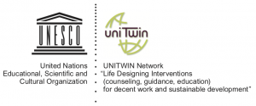

UNESCO-UNITWIN — United States

Slide 2
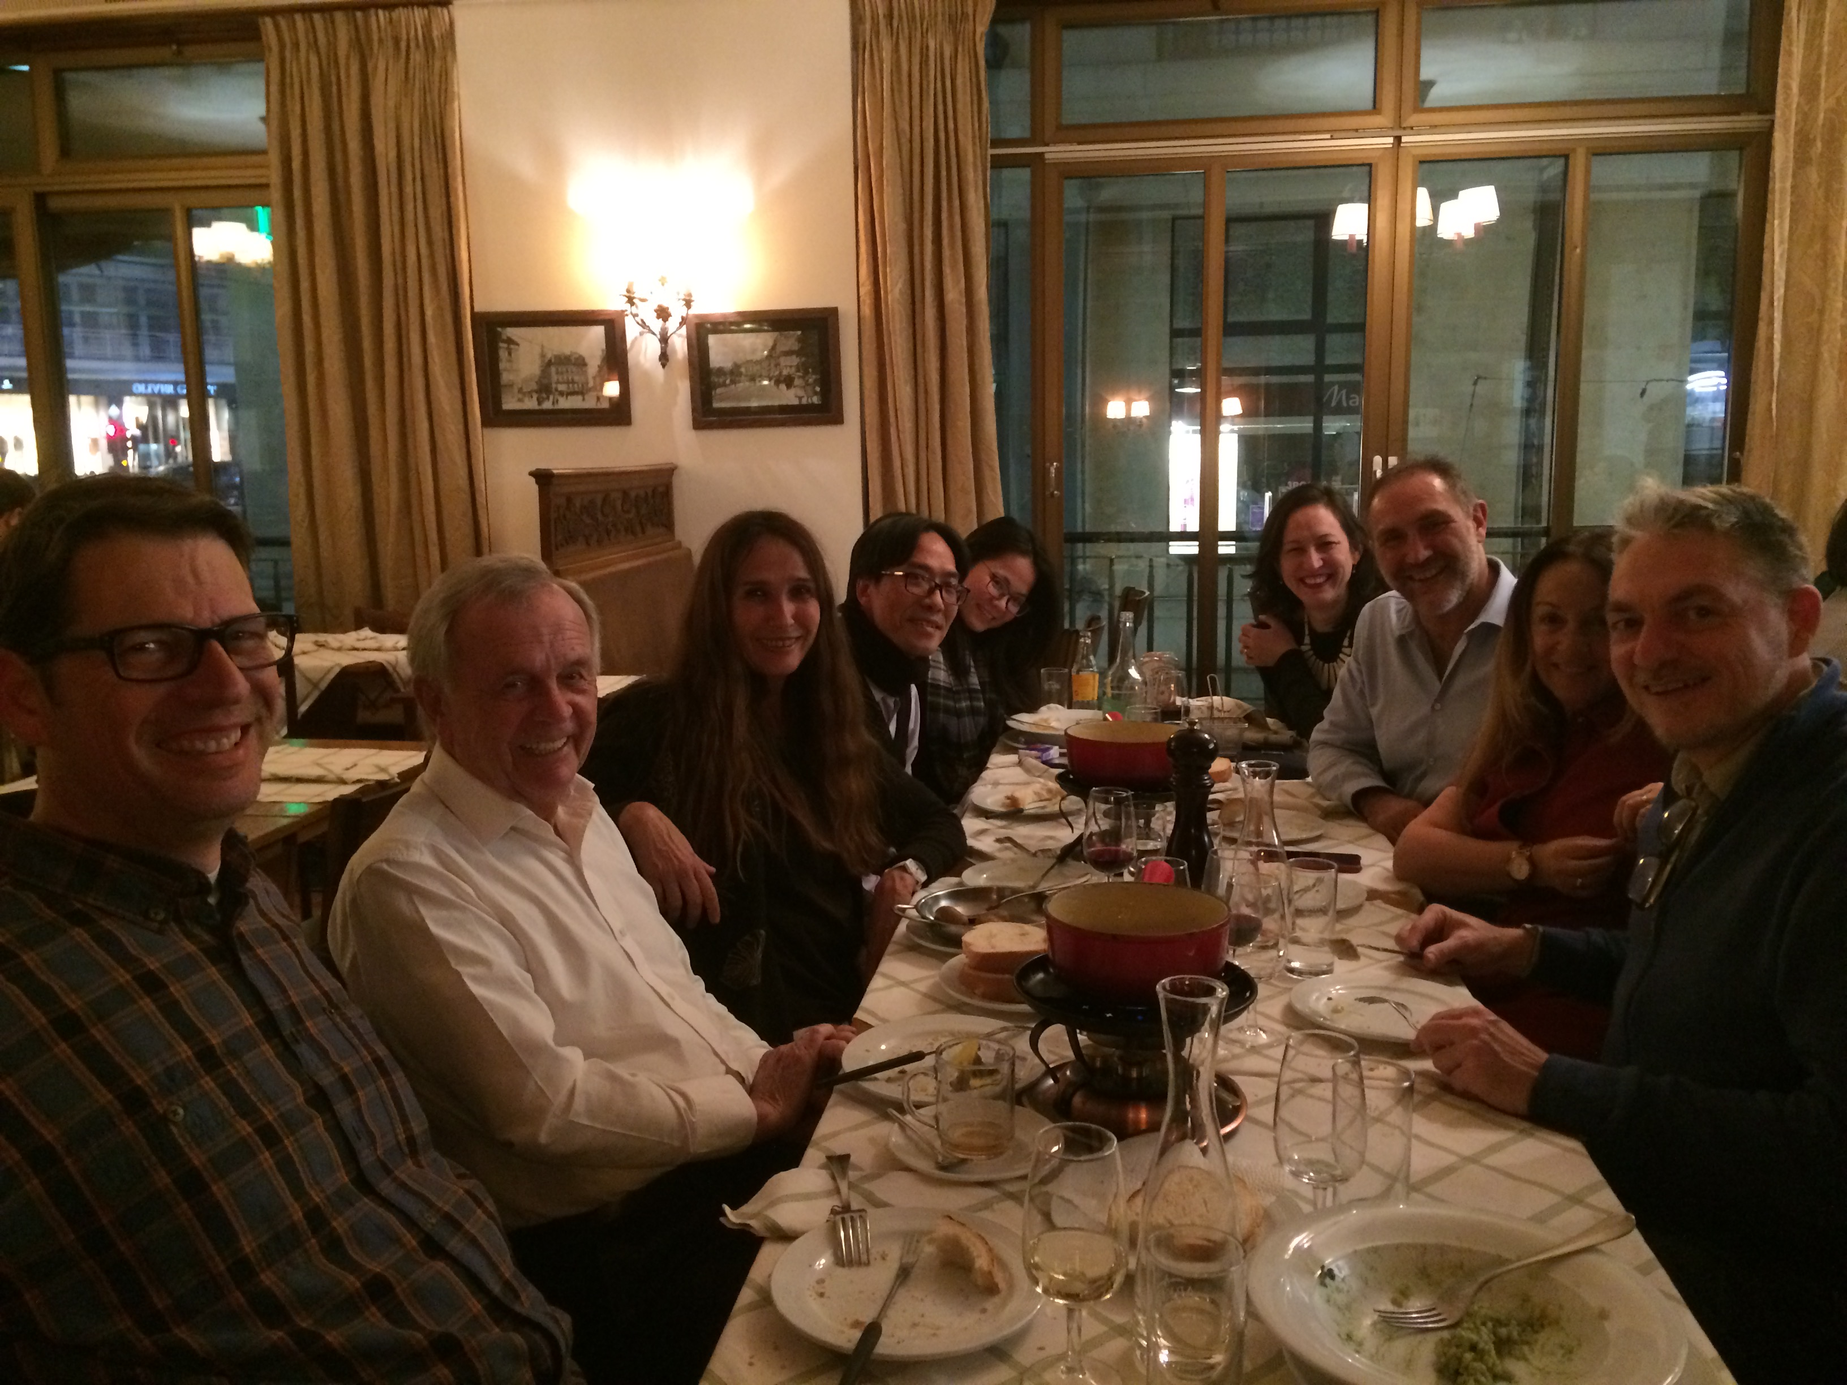
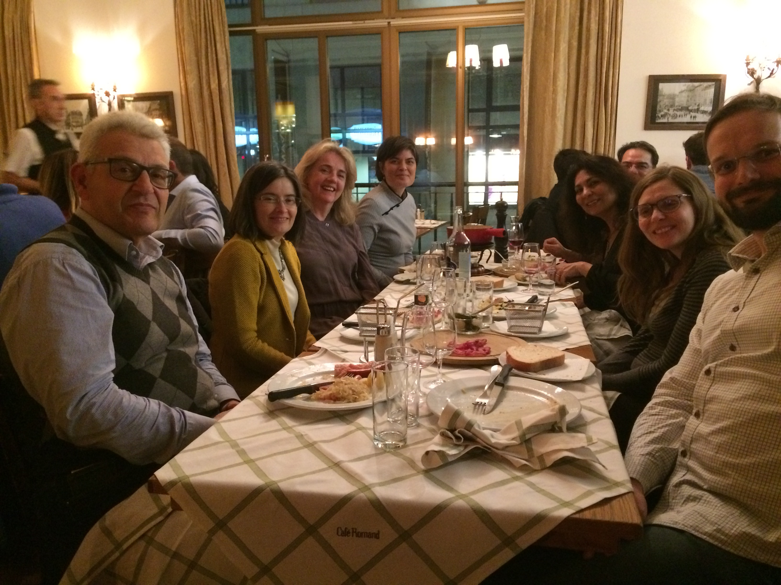

Slide 3
Since UNESCO Approval in 2015, Lesley Unitwin committee members have been active partners
Jason Butler Meenakshi Chhabra Susan Gere Maura McCullough Sue Motulsky Marion Nesbit Kerry Patenaude Donna San Antonio Raquel Stephenson Louise Michelle Vital | Monthly Meetings Annual presentations for Lesley University Representation and presentations at least twice a year at international meetings and conferences Active participation in 4 international publications

Slide 4

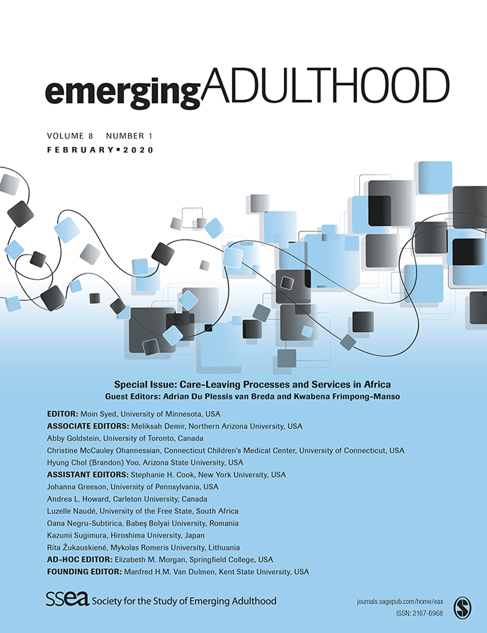
Special Issue of Emerging Adulthood
The Labor of Emerging Adults in International Settings:
A Call for Praxis in a Time of Widening Economic Injustice
San Antonio, Cohen-Scali, Aisenson
Emerging Adults’ Representations of Work: A Qualitative Research in Seven Countries
Cohen-Scali, Masdonati, Disquay-Perot, Ribeiro, Vilhjalmsdottir, Zein, Kaplan-Bucciarelli, Moumoula, Aisenson, Rossier
Decent Work: Representations and Prospects of Work Among Vulnerable Young Argentine Workers
Aisenson, Legaspi, Czerniuk, Valenzuela, Miguelez, Virgili
Emerging Job Precariousness: Work Experiences and Expectations of Low-Qualified Young Workers in Switzerland
Masdonati, Fedrigo, Zufferey
Perception of Decent Work and the Future Among Low Educated Youths in Brazil and Portugal
Ribeiro, Cardoso, Duarte, Machado, Figueiredo, Fonçatti
Possibility and Constraint in the Lives of Young Rural Workers in the US: The Psychology of Working and Post-Trauma Vocational Trajectories
San Antonio, Kaplan-Bucciarelli
Closing Commentary, Opening Conversations: Liminal Reflections on Decent Work, Emerging Adulthood, and Social Justice
Sultana

Slide 5
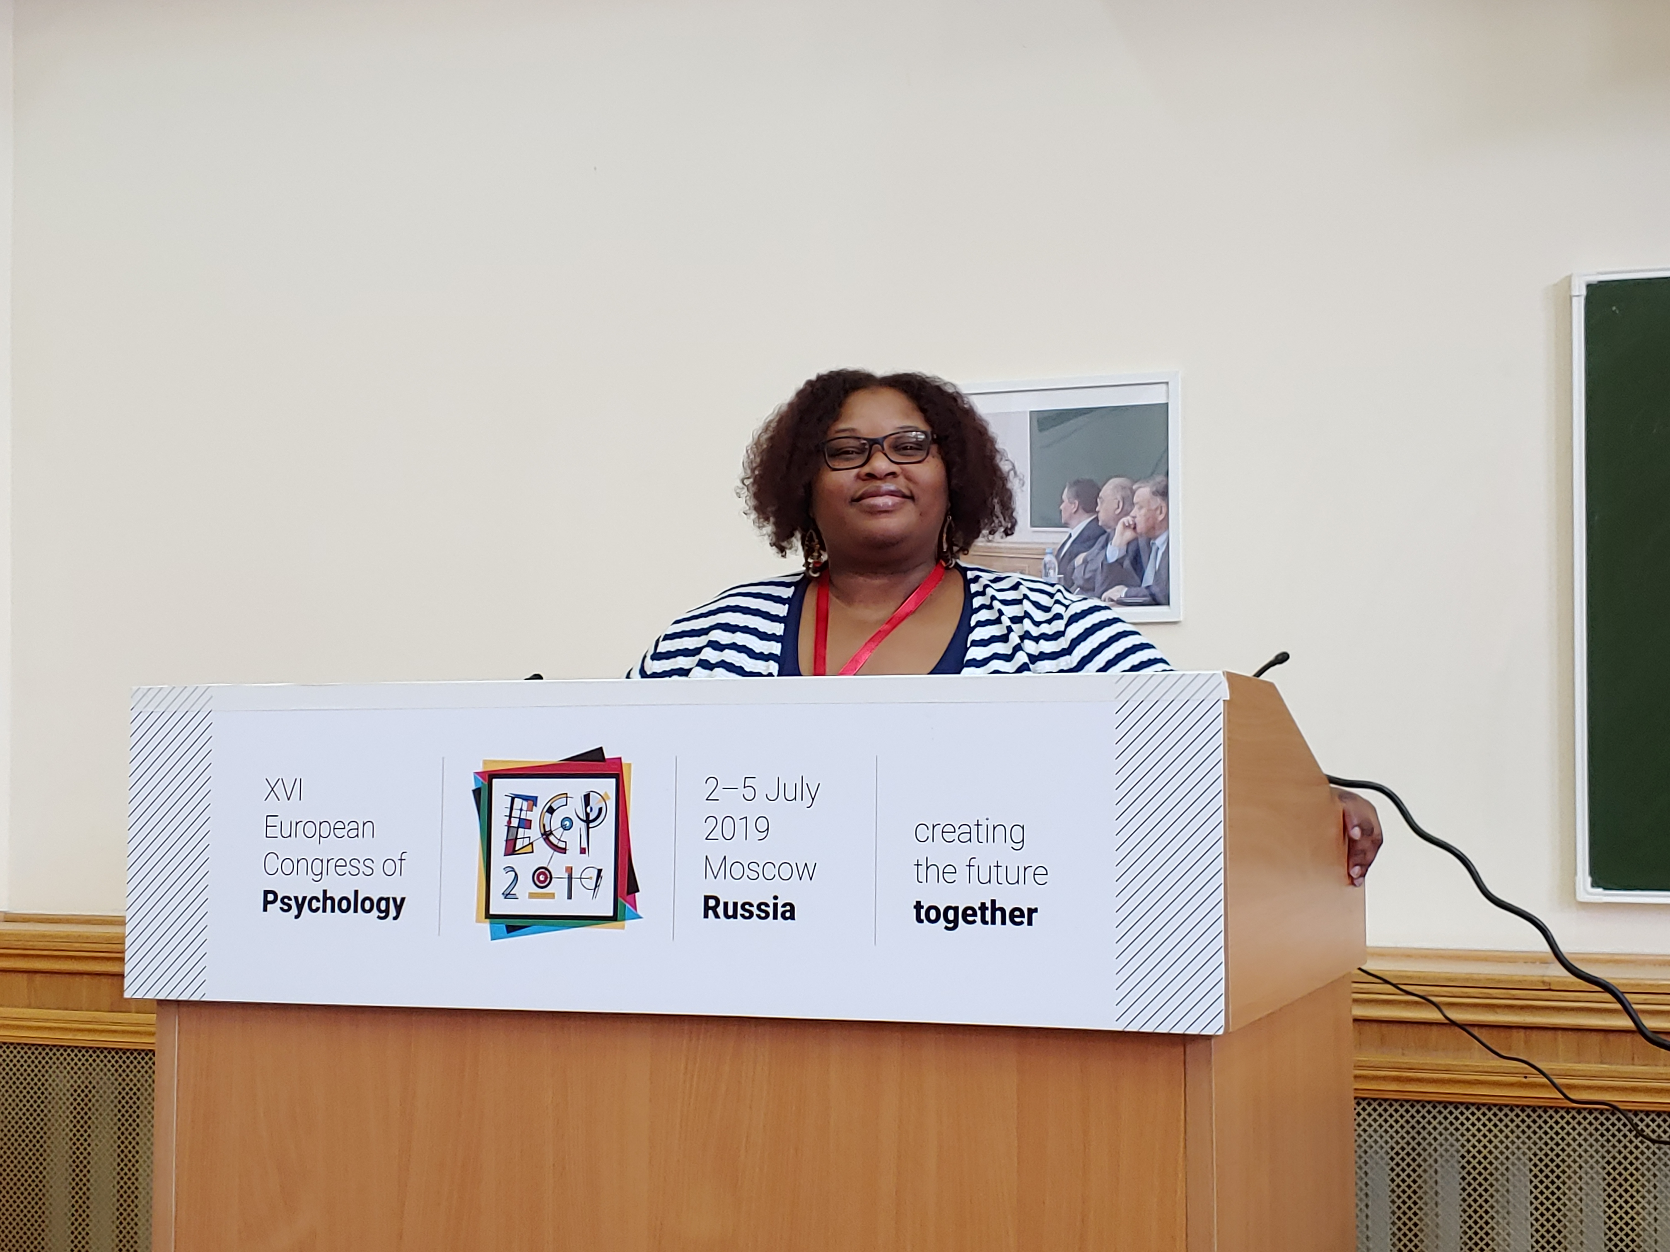
IN THE LAST YEAR…
Michelle’s manuscript “Higher education and career development experiences of emerging adults: A focus on university students and graduates in Haiti” was recently published in the African Journal of Career Development

Slide 6
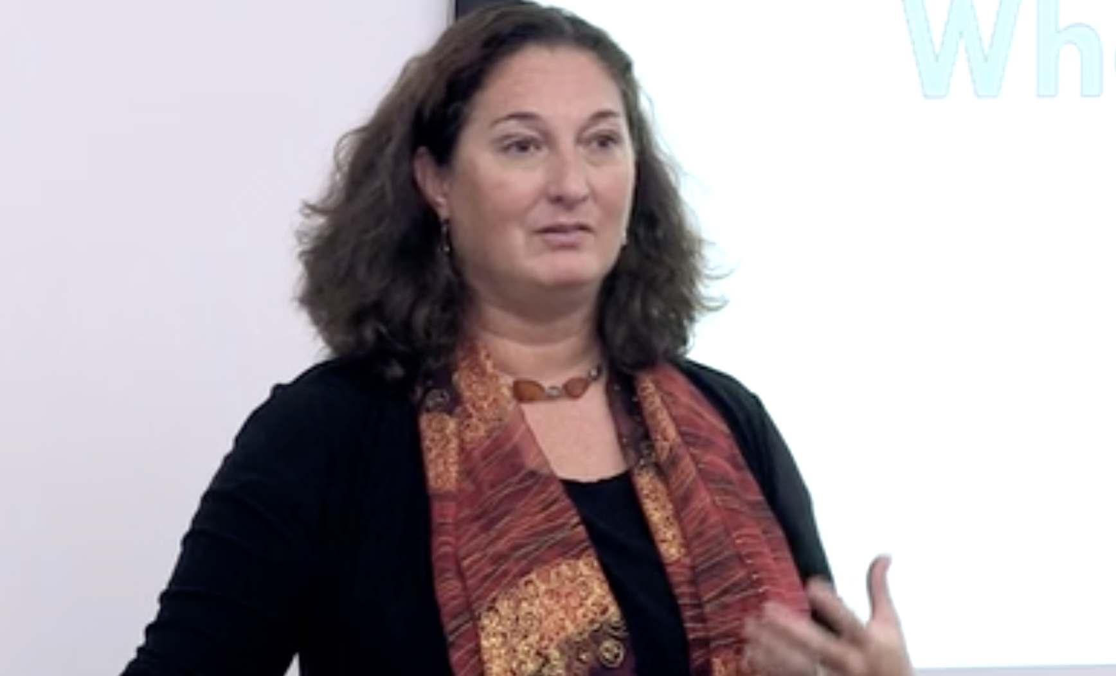
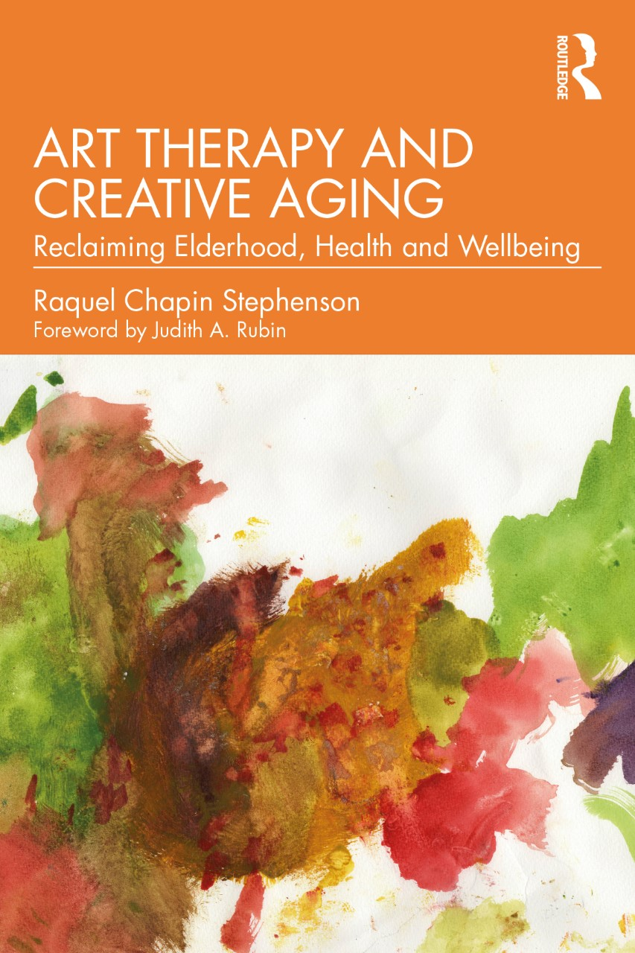
Raquel’s book has been published:
Art Therapy and Creative Aging
Art Therapy and Creative Aging offers an integrated perspective on engaging with older people through the arts, exploring how arts engagement can intertwine with and support healthy aging.
The intersection of arts, aging, health and wellbeing can be adapted as a valuable component of Life Course Design
Life Course Design must include the entire lifespan
Health and wellbeing are human rights, even as we age
Developmental shifts in later life are positive attributes
  For the workplace
  For life enhancement
  For intergenerational support and continuity

Slide 7
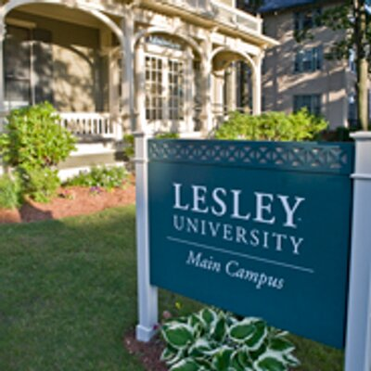
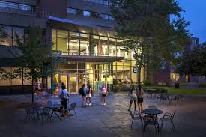
C
UNITWIN
Conference and Meeting
Lesley University 2023

Slide 8
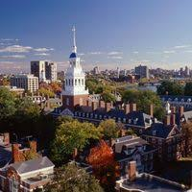
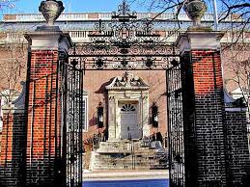
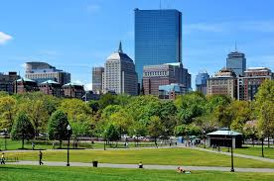
Technology for online participation
International Airport
Art and Music
Walking paths
Affordable places to stay
Four hours to New York City
Three hours to mountains
One hour to beaches
Career counseling colleagues at five other Boston-area universities

