Slide 1
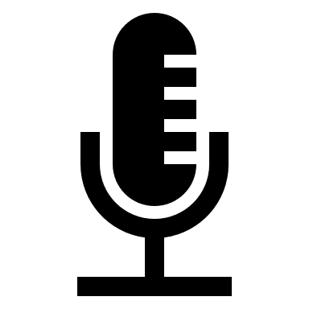
Tips for successful studying and teaching online
Join classes at the agreed time.
Make the commitment to be present for teaching, interaction, and student counselling.
Jointly agree on breaks.
It is polite to turn on your camera when you are speaking. Make sure that you can turn your camera on when necessary.
If your connection breaks or is unstable, use the same link to log in again.
Take notes. Write down your insights and questions.
Bravely turn on your microphone and engage with your teacher and fellow students.
All conversations are confidential. Let’s respect each other.
Stay in touch with your fellow students and keep the conversation going.
A headset microphone prevents background noise and echo.
Jointly agree on how to ask for the floor.
Be yourself. We all play a part in making online teaching successful.

